Slide 1


Building a Kubernetes experimentation platform with
Enabling organisations to put theory into practice
Alex Jones

Slide 2

Speaker
Alex Jones
Director of Kubernetes, Canonical
Tech Lead, CNCF
Governing board Keptn, Open Feature
K8sGPT
https://twitter.com/AlexJonesax

Slide 3
Table of contents
01
What is Open Feature?
02
How might it operate within Kubernetes?
03
How can we perform experiments?
04
Why is this useful?

Slide 4

But what is a Feature Flag?

Slide 5
"Feature Toggles (often also refered to as Feature Flags) are a powerful technique, allowing teams to modify system behavior without changing code."
– Pete Hodgson
https://martinfowler.com/articles/feature-toggles.html

Slide 6

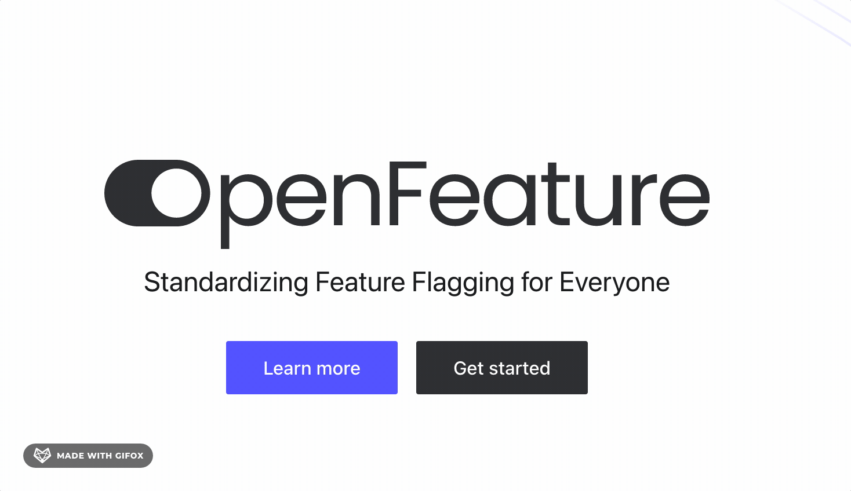
Aren't Feature Flags just…

Slide 7
Where are the gaps?
Open source API
Extensibility
Standardisation
Cloud native

Slide 8


01

Slide 9

Open Feature is…
Created to support a robust Feature Flag ecosystem using cloud native technologies
Started in Feb 2022
20+ founding companies
Feature flag vendors
Software Delivery companies
End users
CNCF Sandbox Project
Standard
Cloud native
Extensible
SDK & API
Open source

Slide 10
Open Feature is…
Created to support a robust Feature Flag ecosystem using cloud native technologies
Started in Feb 2022
20+ founding companies
Feature flag vendors
Software Delivery companies
End users
CNCF Sandbox Project
Standard
Cloud native
Extensible
SDK & API
Open source

Slide 11
Open Feature is…
Adopters
Dynatrace
Ebay
Schweitzer Engineering Labs
Tapico
Utility Warehouse
Standard
Cloud native
Extensible
SDK & API
Open source

Slide 12
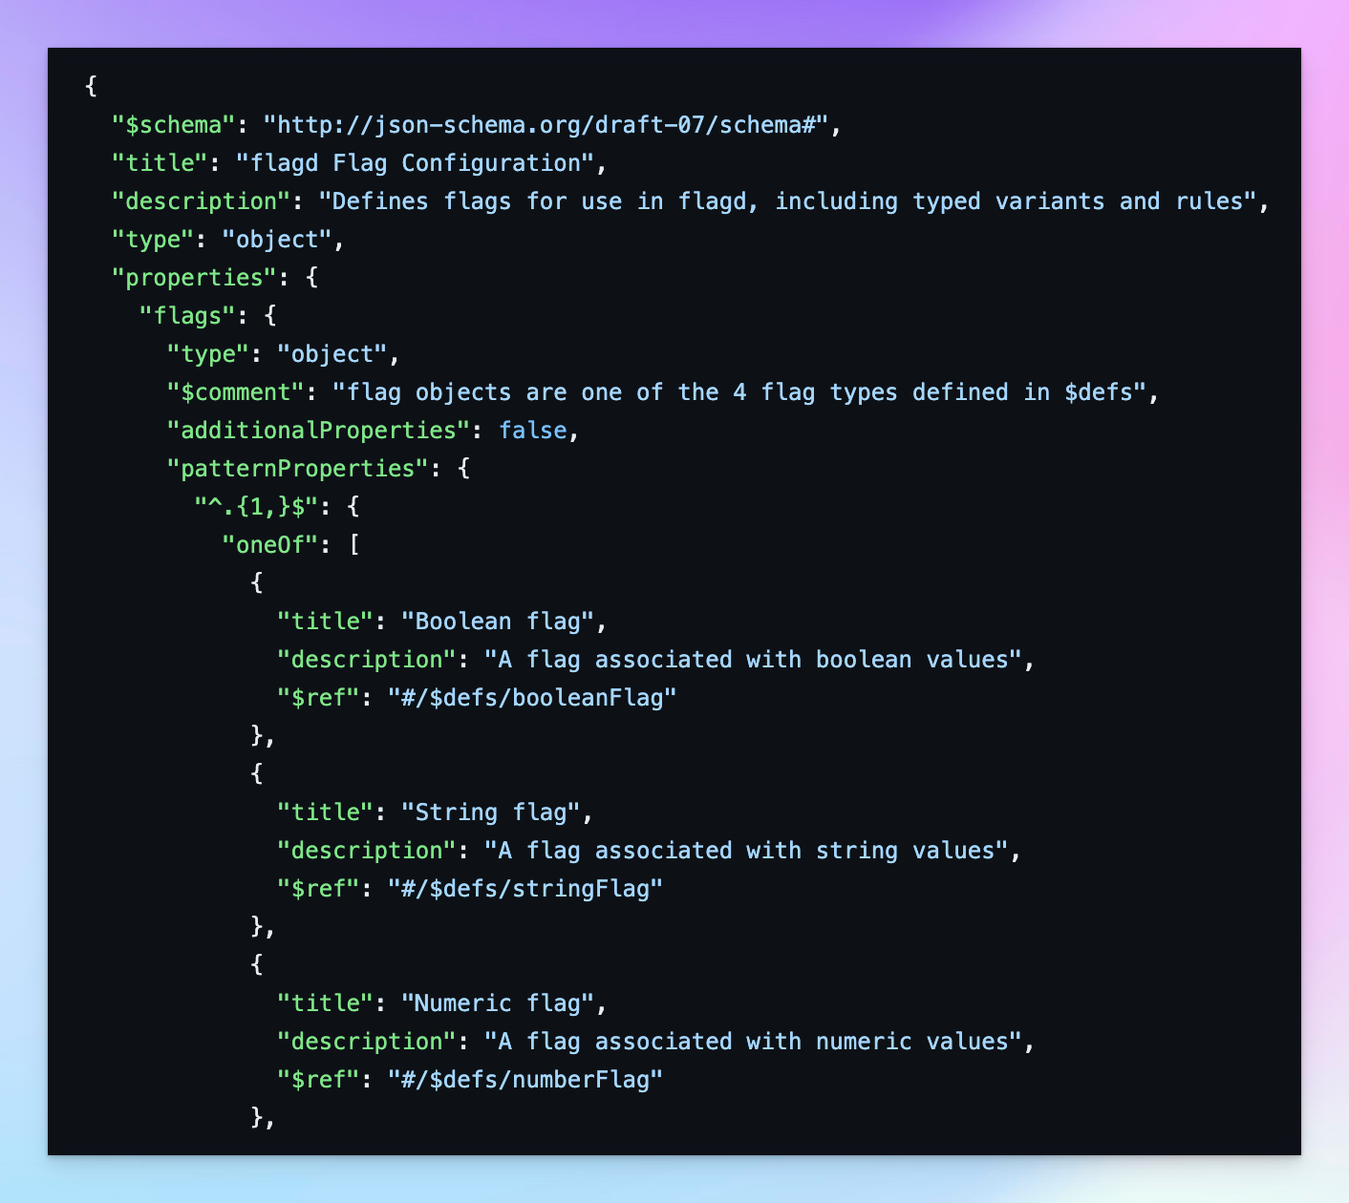
Spec

Slide 13
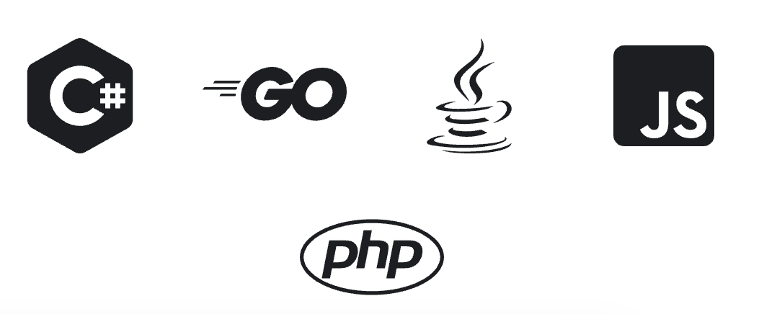
Spec
SDK
Ruby
Golang
Python
Java
JS
DotNet
php

Slide 14

Spec
SDK
Providers

Slide 15
02
&
Kubernetes​

Slide 16
What if we could use Feature Flags beyond the browser?

Slide 17

What if we could use Feature Flags beyond the browser?

Slide 18
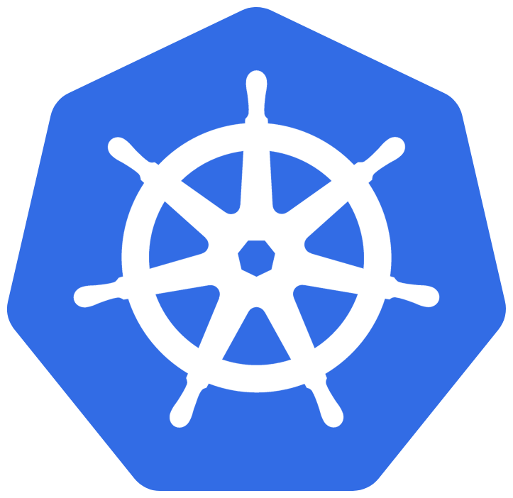
What if we could use Feature Flags beyond the browser?

Slide 19

What if we could use Feature Flags beyond the browser?

Slide 20


flagD

Slide 21
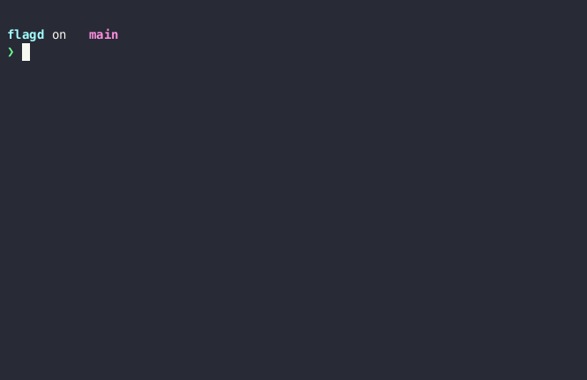


Slide 22


Open Feature
Operator

Slide 23
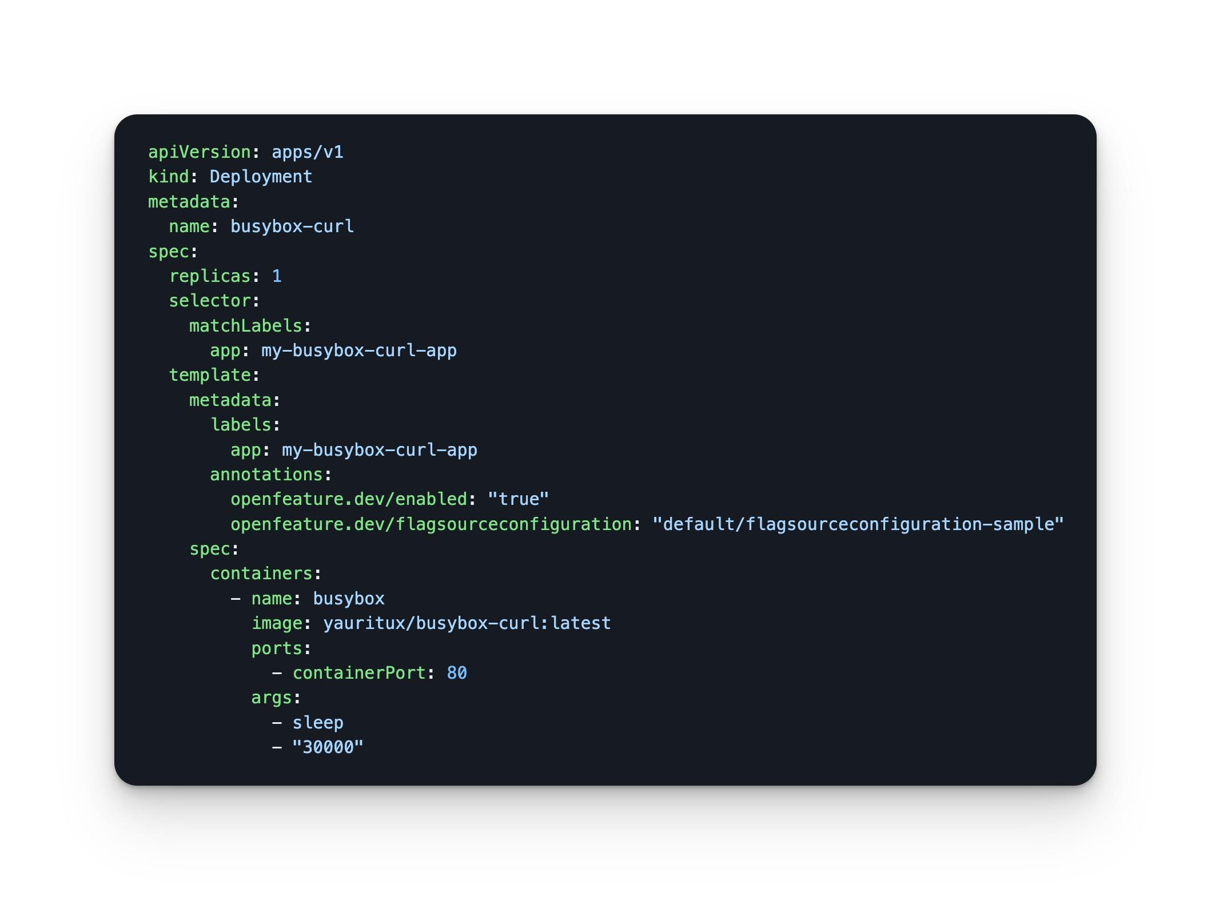
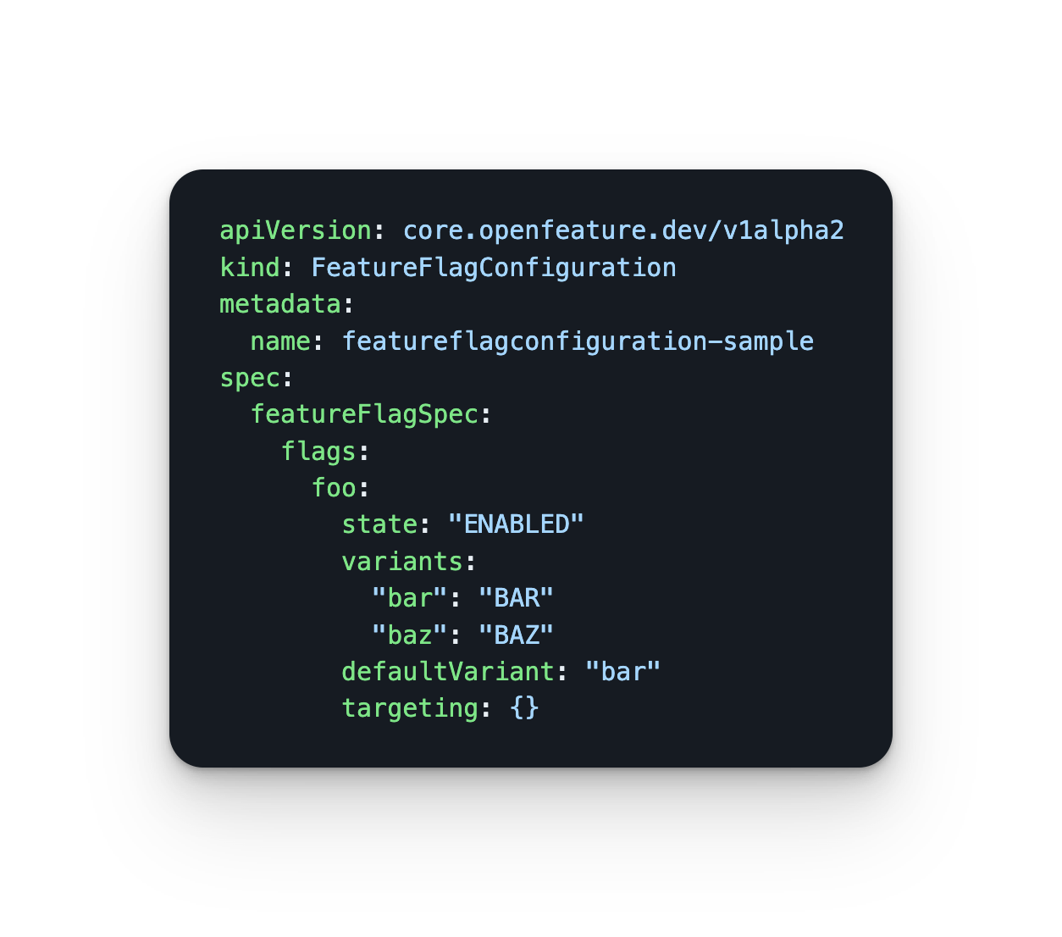

Slide 24

Recap
FlagD
Open Feature Operator
An application for reading a Feature Flag file and serving those flags back over an API
A Kubernetes based application for injecting flagD into workloads that wish to use Feature Flagging.

Slide 25
03
Experiments

Slide 26

"A scientific procedure undertaken to make a discovery, test a hypothesis, or demonstrate a known fact."

Slide 27
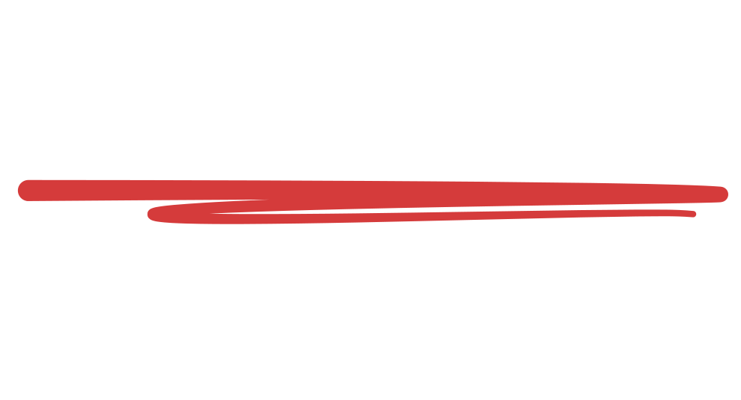
But why?
Typically we test cluster infrastructure and then we test code
Microservice tests typically do not use active infrastructure changes in their context
FeatureFlagging lets you synchronise the conditions of application flow and infrastructure simultaneously

Slide 28
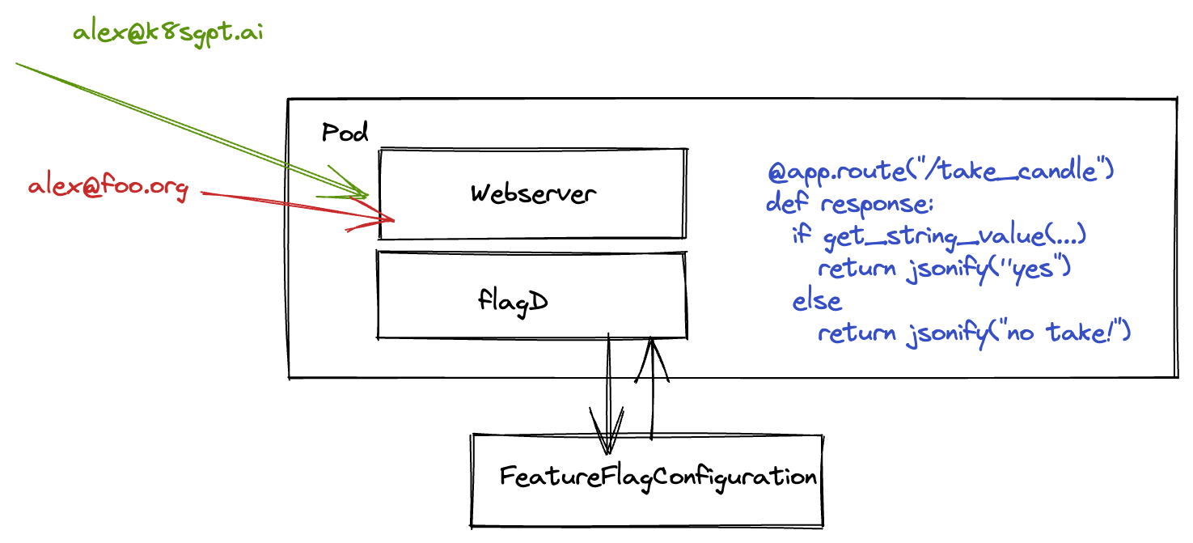
Variant testing
Given we have a simple web server with Open Feature SDK, we can test variants of a response given an input

Slide 29

Crossing the service boundary
Given we have a simple web server with Open Feature SDK, we can use cluster contextual information such as DNS as part of our feature flagging

Slide 30


Building up
The Placement Operator reacts to changes in the FeatureFlagConfiguration.
It will dynamically move Pods around a Cluster​

Slide 31
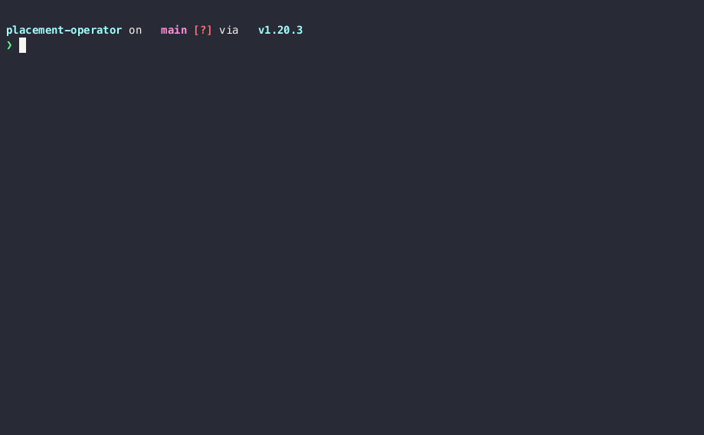

Slide 32
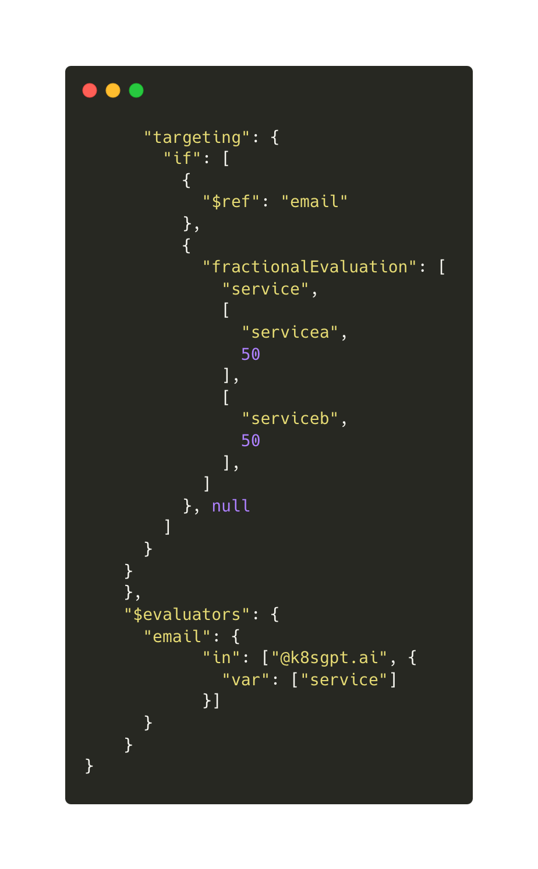
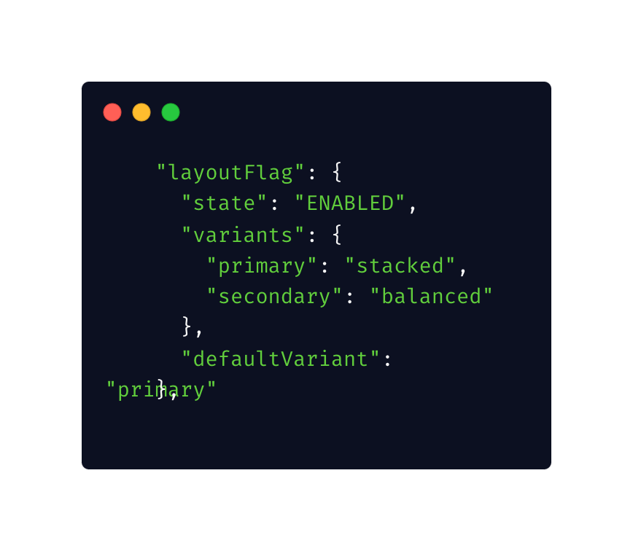
Controlling the conditions

Slide 33
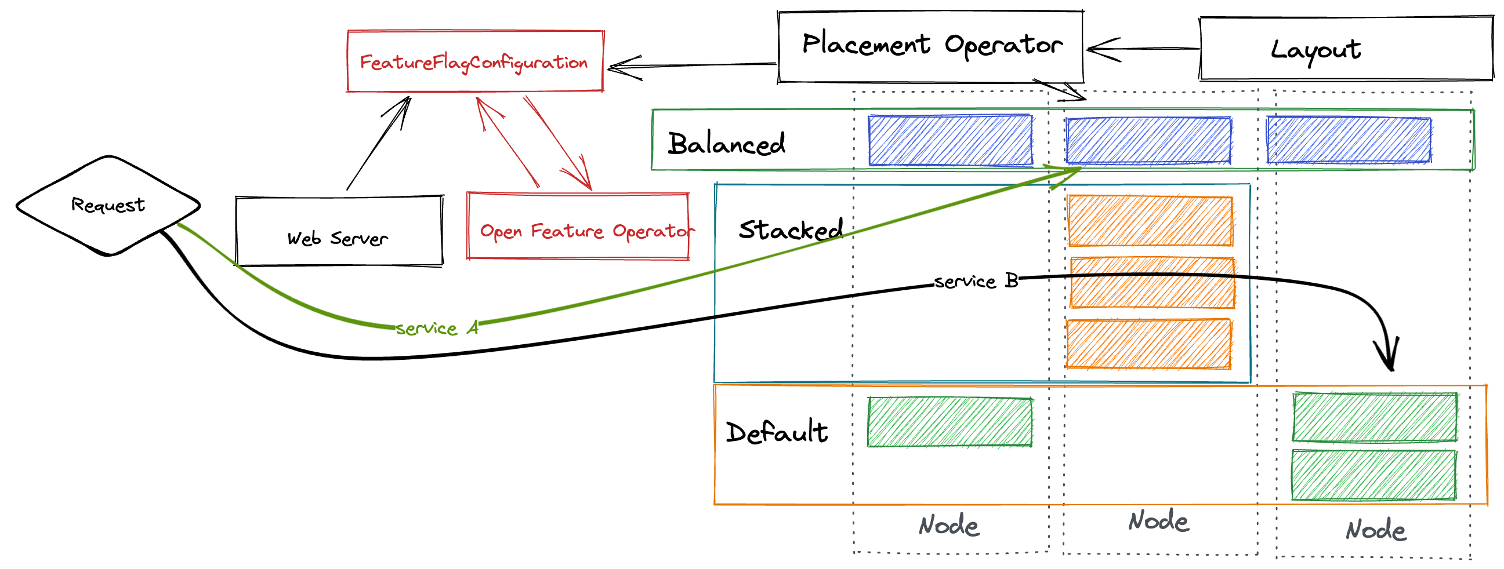
Pulling it together

Slide 34
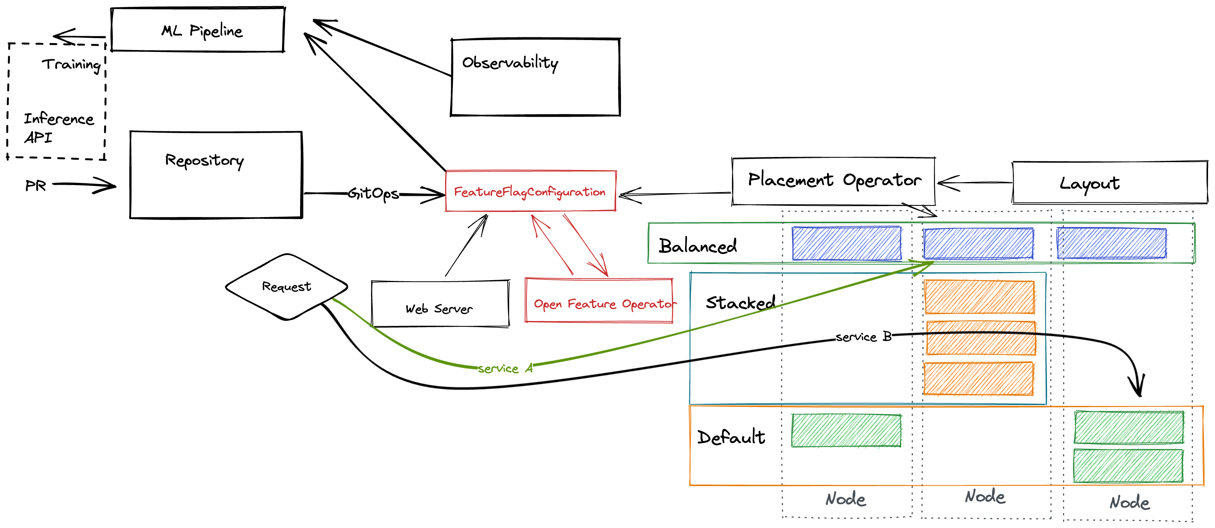
Taking it further

Slide 35
04
The value

Slide 36
Test the impact of blending multiple features together across a variety of services

Slide 37
Situational testing that is reactive to mixed inputs

Slide 38
Experiments across Processes, Pods and Services

Slide 39
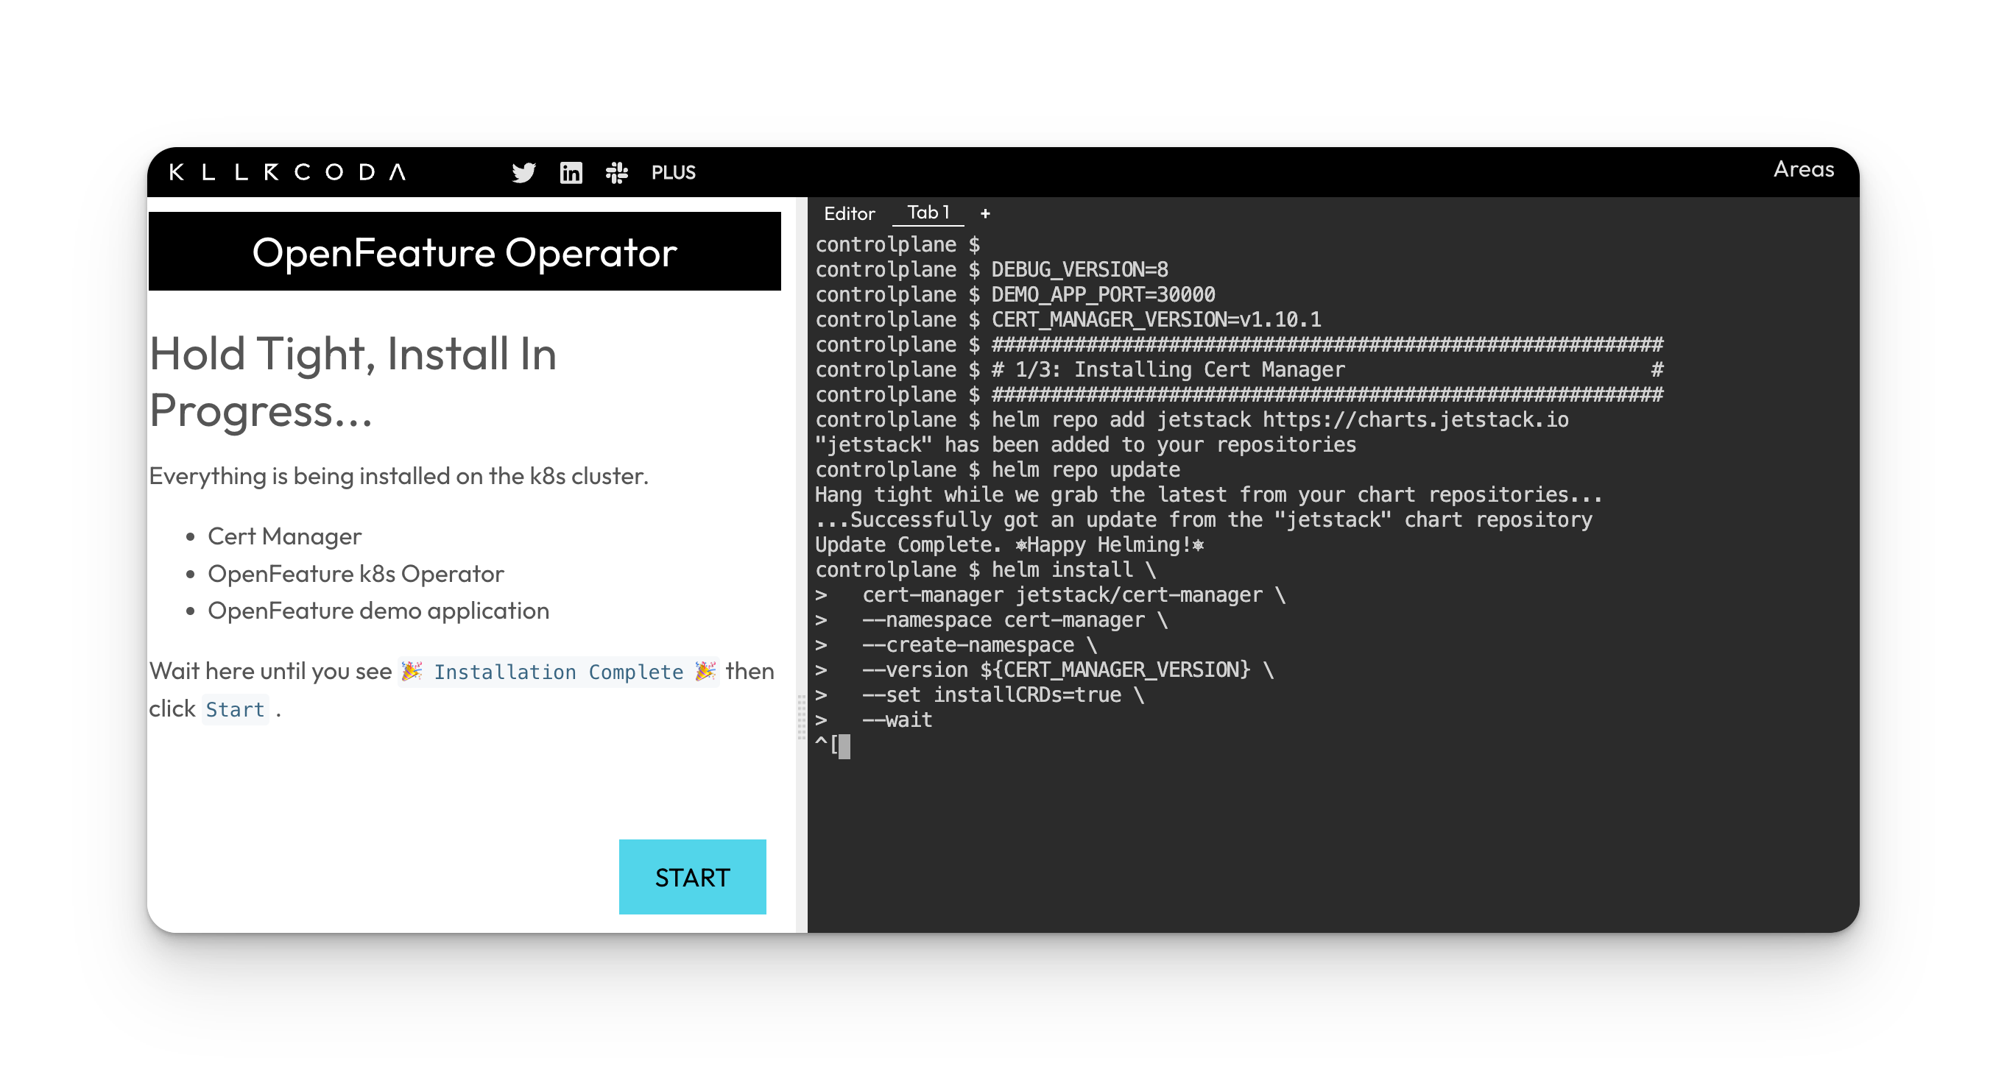
How can I try it out?

Slide 40



Thank you
openfeature.dev
@Alexjonesax

